Slide 1
ESCHERICHIOSES (ESCHERICHIA COLI GASTROINTESTINAL INFECTIONS)
Nosyreva Svetlana, assistant professor
of epidemiology and infectious diseases department

Slide 2
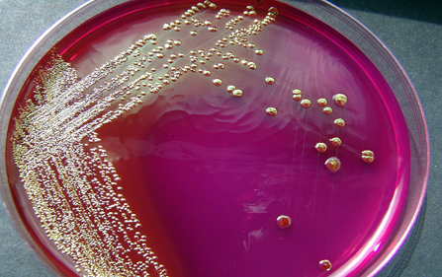
definition
Escherichioses are acute infectious diseases caused by various pathogenic serotypes of Escherichia coli and manifest themselves as enteritis and enterocolitis.

Slide 3
Etiology
About 170 serological types of E. coli are known
E. coli strains
Most are harmless (part of the normal flora of the intestinal tract)
80 serological types are virulent strains (can cause serious diseases)

Slide 4
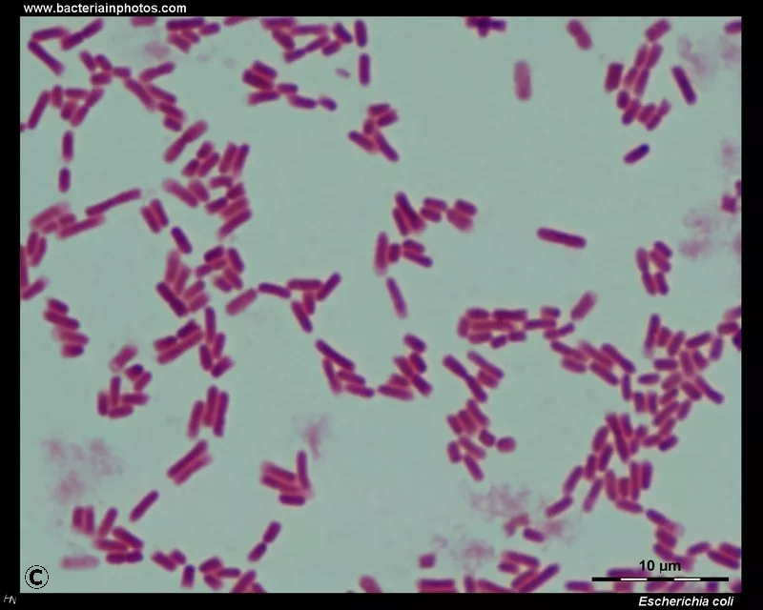
Etiology
E. сoli are:
gram-negative;
non-sporulating bacilli;
оptimal growth occurs at 37 °C;
in the external environment may remain viable for months;
multiply in different food-stuffs, especially in milk;
resistant to desiccation;
may be quickly killed by boiling and disinfectants;
sensitive to some antibiotics, but they may rapidly acquire drug resistance.

Slide 5
Etiology
E. сoli contain
Pathogenic serological types of E. coli are divided into 5 groups:
enteropathogenic (EPEC),
enteroinvasive (EIEC),
enterotoxigenic (ETEC),
enterohaemorrhagic (EHEC),
enteroadhesive (EAEC).
O-Ag
H-Ag

Slide 6
Epidemiology
Human with different forms of the disease, who discharge pathogenic E. coli into the external environment in the faeces are the sources of infection.
Patients with mild or abortive forms of the disease are primary sources of infection.
More rarely the infection can also be transmitted by convalescent carriers.

Slide 7
Epidemiology
Mechanism of transmission is fecal-oral.
ETEC, EIEC and EHEC are believed to spread by food-borne and water-borne routes.
The factors of transmission:
milk,
raw milk,
hamburgers,
vegetable salads.
Besides healthy people may also be infected through hands and different things (toys, spoons, forks), contaminated with faecal material.
EPEC is predominantly transmitted by contact with fomites.

Slide 8
Epidemiology
The communicability depends on the features of the bacteria.
A patient with a ETEC, EHEC is communicable during first days of the disease.
In case of EIEC and EPEC it is usually 1 —2 weeks.
Sporadic cases of the disease occur in many countries of the world. Outbreaks can occur in child daycares, schools, healthcare settings.
ETEC is also known as a causative agent of "travelers' diarrhoea". EPEC cause diarrheal syndromes primarily in infants.

Slide 9
Pathogenesis
Pathogenic serological types of E. coli produce enterotoxin
E. coli
the mouth
multiply in the intestinal tract
The epithelial cells of the small and large intestine
ETEC, EHEC, EPEC
EIEC
invade the epithelium of the large intestine
the adhesive factor adhere to the mucous membrane
they multiply and destroy host cells
inflammatory process

Slide 10
Pathogenesis
All serological types of Escherichia coli produce enterotoxin
enterotoxin enters the bloodstream
may damage the endothelial cells of capillaries
may lead to the necrosis of affected tissues
dehydration and demineralization of the body

Slide 11
Clinical picture
Virulent strains of E. coli are usually responsible for enteritis or gastroenteritis.
The severity of the disease may be different.
The majority of patients have a mild illness.
But some patients with escherichiosis may have severe and sometimes a fulminant course especially in young children, the elderly, or the immunocompromised persons.
The clinical picture of the disease depends on serological type of the causative agent.

Slide 12
Clinical picture
The incubation may last from 6 hours to 7 days.
They adhere to epithelium cells in the small intestine and produce enterotoxin.
ETEC
non-invasive
do not invade the epithelium of the intestinal tract
mild symptoms of intoxication
normal or subfebrile temperature
Diffuse pain over the epigastrium and mesogastrium
Watery stool without smell
accompanied by severe dehydration

Slide 13
The differential diagnoses of ETEC
Vibrio cholerae infection
Rotavirus infection.

Slide 14
Clinical picture
EPEC
the development of enterocolitis
or
the development of enteritis
This clinical form of the disease is more characteristic for children.
Diarrhea may be prolonged, leading to dehydration, electrolyte imbalance and even fatal outcome.
These strains are transmitted by contaminated food or water and by person-to-person.
EPEC cause either a watery or bloody diarrhea
acute tissue-destructive process

Slide 15
dehydration

Slide 16
The differential diagnoses of EPEC
rotavirus infection,
Norwalk virus infection,
Salmonella infection,
Campylobacter diarrhea.

Slide 17
Clinical picture
EHEC
bloody diarrhoea
hemolytic-uremic syndrome
kidney failure without fever
Enterohernorrhagic E. coli 0157 causes the most severe disease.
The E.coli produces Shiga-like cytotoxins
inhibit protein synthesis
cell death
the toxin damages vascular endothelium in the bowel and glomeruli
hemorrhagic inflammatory colitis
the hemolytic uremic syndrome (HUS)

Slide 18
Clinical picture
the hemolytic uremic syndrome (HUS)
hemolytic anemia
thrombocytopenia
renal failure
the disease is most commonly associated with ingestion of undercooked contaminated ground beef.
Less commonly, cases have developed after consumption of unpasteurized milk, spinach, lettuce, and commercial mayonnaise.
A foodborne outbreak may be associated with raw tomatoes, cucumbers, and leaf salad.
This infection is found primarily in industrialized nations and usually occurs during the summer months.

Slide 19
The differential diagnoses of EHEC
Shigella infections,
Clostridium difficile enterocolitis,
ulcerative colitis/Crohn disease,
ischemic colitis,
diverticulosis,
appendicitis.

Slide 20
Clinical picture
EIEC
produce no toxins, but severely damage the intestinal wall through mechanical cell destruction
utilize adhesin proteins to bind to and enter intestinal cells
highly invasive
moderate symptoms of intoxication (weakness, headache, loss of appetite)
The stool becomes liquid and may contain mucus and streaks of blood
Bowel movements are sometimes accompanied with tenesmus
acute onset
often normal temperature, but sometimes subfebrile or high temperature
spastic pains in the lower part of the abdomen are localized
Rectoromanoscopy may reveal catarrhal, catarrhal-haemorrhagic or catarrhal-erosive process in the mucosa of the rectum and the sigmoid colon.

Slide 21
The differential diagnoses of EIEC
shigellosis
amebic dysentery

Slide 22
Clinical picture
EAEC
non-invasive
bind to epithelium cells in the small intestine
watery diarrhea without fever
The diarrhea is often prolonged.
These strains are contracted by ingesting contaminated water or food.
EAEC is reported in developing countries and is the second most common cause of traveler’s diarrhea.
The differential diagnoses of EAEC include Vibrio cholerae infection and Rotavirus infection.

Slide 23
Complications
May develop:
dehydration,
acute renal failure,
a toxic shock,
cholecystitis,
pneumonia and others.

Slide 24
Diagnosis
Diagnosis of escherichioses
a careful analysis of epidemiological data
clinical picture of the disease
laboratory investigations
Frequently bacteriological investigations are used.
For this test stool specimens should be collected after the beginning of diarrhoea, and before the administration of antibiotic treatment.
The laboratory diagnosis is made by culturing on different media and determining a serological type of E. coli.
In rare cases E. coli may be isolated from blood, bile and CSF.

Slide 25
Treatment
In mild cases patients may be treated at home.
But in severe escherichiosis patients must be hospitalized.
During the acute period of the disease diet Ns 4 is recommended for such patients.
In patients with mild dehydration fluid loss and electrolyte depletion are replaced by oral fluid intake.
In cases with severe dehydration intravenous fluid replacement is administered.
Symptomatic therapy is necessary as well.
In severe cases antimicrobial drugs (amoxicillin, cephalosporins, ciprofloxacin and others) are used.
The duration of antimicrobial therapy is 5—7 days.

Slide 26
Treatment
Antibacterial therapy:
Enterotoxigenic E. coli: ciprofloxacin 500 mg per os twice daily × 3 days (for severe disease), rifamixin 200 mg per os every 8 hours × 3 days.
Enterohemorrhagic E. coli: Antibiotics are not useful in EHEC and may predispose to development of HUS.
Enteroinvasive E. coli: ciprofloxacin 500 mg per os twice daily; rifamixin 200 mg three times a day × 5 days. Antimotility agents are contraindicated in persons with enteroinvasive E. coli (EIEC) infection.
Enteropathogenic E. coli: ciprofloxacin 500 mg per os twice daily × 3 days (for severe disease), rifamixin 200 mg per os every 8 hours × 3 days.
Antimicrobials known to be useful in cases of traveler's diarrhea include fluoroquinolones, rifaximin and in some cases trimethoprim/sulfamethoxazole (TMP/SMZ). They shorten the duration of diarrhea by 24-36 h.

Slide 27
Prevention
Prevention of escherichioses is based on the:
keeping of appropriate hygienic conditions at home
in children's institutions,
food shops,
canteens,
provision storehouses and others.
Handwashing before eating, water purification, avoid raw fruits and vegetables unless peeled, choose steaming hot foods.
Sanitary and hygiene rules must be strictly observed.
Final disinfection is performed at the focus after hospitalization of the patient.
Revealing a source of infection and diagnosis are based on the clinical signs, results of the laboratory tests, and data of epidemiologic anamnesis.

Slide 28
Anti-epidemic measures in the E. coli infection epidemic focus
Measure | Content
Measures directed to the infected individuals
Registration and notification | Routine procedure
Isolation | Isolation may be conducted by household isolation or by hospitalization. Household isolation is possible for patients with the mild forms if anti-epidemic regimen can be organized at home. Hospitalization is conducted by clinical indications (severe forms of the infection in children under 2 years, patients with severe concomitant diseases), by epidemiologic indications (a patient belongs to the decreed group).
Treatment | Patients are treated according to the examination and treatment standards for infectious and parasitic diseases till their complete clinical recovery.

Slide 29
Discharging from hospital | A person can be discharged after the clinical recovery. For children attending daycare facilities, persons belonging to the groups listed above: after 1 negative result of the laboratory examination conducted in 1 —2 days after treatment. If the result is positive, additional microbiologic examination is ordered.
Admission to educational set-tings or work | It is possible in case of the complete clinical recovery, and a negative bacteriological test.
Follow-up | Clinical follow-up during a month after convalescence is necessary primarily for persons of the decreed groups.
Measures directed to the infected animals
Isolation, treatment, sanitary and veterinary measures.

Slide 30
Measures interrupting the mechanisms of transmission
Current disinfection | It is conducted by a patient himself or by people caring for the affected person. In home the patient's room should be cleaned and aired 2—3 times a day. A patient is provided with individual bed linen, towel, eating utensils, and healthcare items. The patients dirty laundry is gathered and stored separately. All surfaces in the room, patients dishes, linen, toys, and toiletries should be disinfected.
Final disinfection | It is conducted after hospitalization of the patient as soon as possible.

Slide 31
Measures directed to contacts (persons contacted a source of infection)
Identification | Persons being in contact with the patient in the child daycare facility, school, or at home are revealed when the first symptoms of the disease appear.
Clinical check-up | It includes the evaluation of the health condition, temperature (twice a day), and stool. The date of the disease onset should be determined too.
Collecting epidemiologic anamnesis | History-taking should contain knowledge of contacts with the affected patients, information about travelling to the territories with a high risk of the infection, consuming undercooked beef, unpasteurized milk and juice, raw fruits and vegetables, contaminated water.

Slide 32
Medical observation | Medical observation is organized for persons who contacted the cases. It lasts 7 days since the moment of leaving the source of infection. The contacts among children attending kindergartens and schools, adults, belonging to the groups listed above, should undergo a bacteriologic examination of feces.
Regimen and restriction measures | The affected groups (classes, patients in the wards) should be isolated from unaffected groups. They do not participate in the actions being conducted with the members of the unaffected groups. Self-service should be cancelled in the groups under medical observation.
Post-exposure prophylaxis | Is not conducted.
Hygienic education | Health officers organize public education on the danger of the disease, its clinical signs, and prevention of E. coli infection.

